Slide 1
Module 3: Suggesting and implementing strategies for a protective VET environment Lesson 3.1: How to deal with objections Unit 3.1.4: How to do conflict management, VET Teacher training related to objections
Training Materials
for VET Teachers/Trainers

Slide 2
Learning Objectives
By the end of this topic, the learner should be able to:
realize that fear of crisis or conflict may be realistic but also exaggerated
know how to prevent conflicts by offering an effective preventive training
know how to prevent conflicts by helping to develop a vision and a matching spiral curriculum
analyze and help manage a crisis

Slide 3
Key Words
Fear
Training
Spiral curriculum
Taxonomy of affective objectives
Indoctrination
Organizational change
Innovators, early adopters, early and late majority, laggards
Risk assessment
Conflict escalation ladder

Slide 4
Contents
Part 1: Introduction
Part 2: The fear of conflict
Part 3: How to develop training
Part 4: Developing a vision and a matching curriculum
Part 5: Conflict management
Part 6. Closing comments

Slide 5
The fear of conflict
Before we go into practical details about how to prevent and manage conflicts and crises, we would like to go into the fear of conflicts. The topic of sexual and gender diversity is controversial for some people. Opponents, as well as activists and supportive professionals, can be challenged by fear of conflict and the resulting risks. This fear tends to be in the way of rational and logical consideration of real risks. When you are ruled by fear, you may take decisions based on your fear rather than on an objective assessment. Below, you will learn how to deal with this fear of risk.

Slide 6
Self reflection activity: the fear of coming out
Read the below case study and choose one of the suggested ways of dealing with the case. Note that none of the answers is incorrect. The feedback we offer is meant to help you reflect on your choice.
A rather effeminate looking boy comes to you because he considers you to be a VET Teacher he can trust. When you two are alone in a counselling room, he bursts into tears. He met another boy he really likes and he feels he cannot hide his homosexual orientation anymore. He wants to tell his parents, but he expects that because they are quite religious, they will be shocked and that they will throw him out of the house. He wails that he will be without a roof above his head, without money and that he will have to stop his vocational training. How would you react?
A. I would console him and tell him not to be afraid of things that may not be real
B. I would ask him what reasons he has to expect that his parents will reject him
C. I would list all the things that could happen and help him think of solutions for each scenario
D. I would practically help him prepare for the risks, for example referring him to a shelter
Notes:
INSTRUCTIONS FOR IT:
A. Having empathic attention for his fear is a good first step. It may be that his fears are exaggerated and may not become true in reality, but you cannot make that assessment. So telling him not to be afraid without consideration of the real risks is not an adequate advice.
B. It is good to check whether fears are based on an irrational fight or flight response, or they are based in a realistic risk assessment. You can help the boy to find this out by asking such a question. It would be good to first be empathic about the fear, because otherwise the boy may not be able to hear your more cognitive suggestions for analysis.
C. It seems that the boy is only worried about the consequences of his coming out and that there are no other complicating challenges like a lack of social support, drug use, or a threat of honour revenge. Also, it would be better to first give attention to the fear itself rather than just start to analyze this is a complicated risk situation.
D. Even though this might not be the primary task of the (VET) school, it would be good if it has a social referral chart. But in this case, it may be better to first talk about the fear and if it is realistic, and then go on to discuss risk scenarios and solutions, and then to cap this off with concrete suggestions when it comes to such a crisis.

Slide 7
Cherish the fear (1/2)
It is extremely common that LGBTIQ+ people feel very afraid of the reactions to their coming out. All of their lives, they have gotten negative messages about how bad it is to be lesbian, gay, bisexual or transgender. It is difficult to imagine that even their loved ones will react in a positive or supportive way.
However, in practice two thirds of the parents react not as bad as the young person expects. In most cases, parents love their children and do not want to break this bond. Some parents may be worried about discrimination, STDs and other risks they relate to being LGBTIQ+, often because their images of homosexual orientation and gender transition change are loaded with prejudice. They may feel more or less shocked because their child appears to be different from their normative expectations. They may need some time to get used to a new perspective of their child.
Often parents already have some thoughts about the heterosexual orientation or gender identity of their child. In this case study, the boy appears relatively effeminate. The boy does not report any previous bad treatment by his parents because of this, so it may be that the parents already have a tacit expectation that the boy is not heterosexual or cisgender. Breaking this taboo may actually be a relief to them.

Slide 8
Cherish the fear (2/2)
When cisgender heterosexual VET teachers engage with the topic of sexual and gender diversity, they can experience a similar type of fear. This is not such a serious fear as LGBTIQ+ people may have themselves, but VET teachers may still feel apprehensive about negative reactions and ultimately about the risks for their social and professional position in the VET institute. It is important to accept that these fears exist, but at the same time not to give into them.
Our advice is to “cherish the fear” because this is an emotion that belongs to you. At the same time, we advise to consider if the fear is due to an irrational fight or flight instinct, or whether it is based on real risks. When you are able to face the real risks with an objective gaze and some courage, you can develop a strategy to handle any risk.

Slide 9
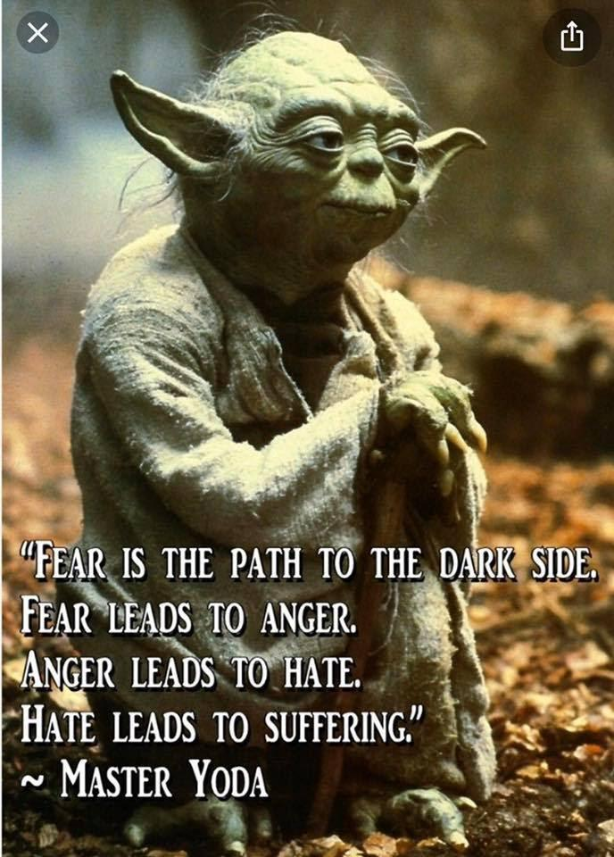
Cherish the fear (2/2)
When cisgender heterosexual VET teachers engage with the topic of sexual and gender diversity, they can experience a similar type of fear. This is not such a serious fear as LGBTIQ+ people may have themselves, but VET teachers may still feel apprehensive about negative reactions and ultimately about the risks for their social and professional position in the VET institute. It is important to accept that these fears exist, but at the same time not to give into them.
Our advice is to “cherish the fear” because this is an emotion that belongs to you. At the same time, we advise to consider if the fear is due to an irrational fight or flight instinct, or whether it is based on real risks. When you are able to face the real risks with an objective gaze and some courage, you can develop a strategy to handle any risk.

Slide 10
Reflections on your own fears
Click on the fears you possibly have and read our feedback. The feedback may help you to take a step back and reflect:
1. They will criticise me for having wrong values
2. They will think I am unprofessional
They will start to distance themselves from me
I will lose my job
This Photo by Unknown Author is licensed under CC BY-SA-NC
This Photo by Unknown Author is licensed under CC BY
This Photo by Unknown Author is licensed under CC BY
This Photo by Unknown Author is licensed under CC BY-ND
Notes:
INSTRUCTIONS FOR IT:
This fear may be an insecurity about whether you can deal with social pressure to conform to certain norms. The ‘correct’ norms are the norms that are common in your peer group. You could reflect on how easy or challenging it is for you to defy social norms in some cases. Note also this thought involves a judgement about what are right and wrong values. Reflect on why your instinct leads you to make such judgments. You can also reflect on the criticism part of this thought. Criticism can be hard to take. You could also reflect on how you can only deal with criticism.
This fear is very common for all professionals. On the surface, it is considered “professional” to be restrained, expert and not showing emotions or too much involvement. But it is good to realize that true professionals are authentic and make a balanced combination between their expertise and their personal involvement. There is nothing wrong with having a personal mission within your institutional and professional environment. This will just make your professionalism deeper and stronger. You could reflect on what your self-image as a professional is and how you developed this notion.
This fear is a very basic fear for all humans. We are social beings and social isolation is maybe the worst punishment. But be aware that taking distance is a natural phenomenon. When people are sensing that you do something that they feel uncomfortable with, their natural response is to fight it or flee from it. The “flight” reaction often comes down to taking a social distance. You can overcome this by re-establishing the connection. Stress that you’re just one of them, with the same feelings and doubts. Reflect on how easy you deal with social distancing and if you are good in connecting.
Losing your means of existence is very threatening, so this fear has a high pitch. You could wonder whether it is a realistic fear and why you have this fear. Maybe your job status is insecure and the management does not have a supportive vision, then this type of fear may be more or less realistic. Maybe you have a steady job and the fear of being fired is somewhat exaggerated. Reflect on why you would have this high fear. If you are able to take a step back and consider potential scenarios, you can develop strategies to improve your job security, also in times of crisis.

Slide 11
Essential remarks
All the “fears” in the previous exercise are thoughts. It is helpful to look beyond the cognitive aspect of the thought and to focus on the underlying emotion.
Do you feel insecure?
Anxious?
Angry?
Doubtful?
Scared?
Paralyzed?
(There are numerous other feelings that you may feel)
- Does this feeling relate to earlier experiences that you had? Connect with your feelings and where they come from.

Slide 12
Essential remarks
Realize that your feelings are separate from others’ feelings. Other people may have other feelings but these are their feelings. Their feelings do not cause your feelings. Your feelings come from yourself and your own interpretations and judgments. Experience your feelings and accept that they are there, but do not act out of fear. Once you feel space to turn your gaze outward, look at your conversation partner, or to the situation, and wonder what is “alive” in others. This curiosity will help you take the next step forward.
In the next parts of this unit, we will go into preventive ways to prepare for, and to avoid risks. We will first go into how to raise the competence of colleagues through training, and then on how to develop a supportive vision and a Curriculum that supports such a vision.

Slide 13
Developing a vision and a spiral curriculum
A clear vision and its logic translation into a matching curriculum will help us remain steadfast in times of crisis.
But how a VET institute can formulate a vision and translate it into a matching curriculum? We will explore this from the perspective of individual VET teachers who can speak to their team leaders or higher level managers and advocate for adequate implementation of education about sexual and gender diversity and a safe and inclusive environment for LGBTIQ+ VET students.
https://slideplayer.com/slide/2717131/

Slide 14
The importance of a VET school vision on diversity
Most VET teachers function quite autonomously. Some feel stimulated and supported by their VET institute policy, and others prefer to follow their own path within the given limits. It is especially when you teach topics that may be controversial, that the importance of a company vision becomes clear.
When the VET institute has the mission to train high-quality workers, and the vision is to prepare their trainees for how they can be flexible in the labour market and how they can effectively deal with diversity, a VET teacher can feel legitimated to give attention to all forms of diversity, including sexual and gender diversity.
Of course, such a vision should be translated into practice. If a parent comes to school and demands to speak with the team leader, it may be that the team leader is afraid of confronting the parent. When he or she does not defend the institutional vision, the VET teacher may lose legitimacy in teaching diversity. If a VET teacher wants to teach about sexual and gender diversity as part of the institutional vision, but there is no teaching material, or the current curriculum is heteronormative, then the vision of the institute is also not implemented adequately.

Slide 15
How to integrate sexual and gender diversity in the vision of an institute
Of course, VET institutes have already had a mission statement and vision. If this does not include diversity, there are many ways to include it.
When the vision does give attention to diversity, but only to cultural diversity, then there is already a basis to extend to sexual and gender diversity, but it does require a shift in thinking about what diversity entails.
Some schools or VET institutes also make reference to an intervention for inclusion. Traditionally, the concept of “inclusion” in education strictly refers to include disabled students. The idea that inclusion embraces a wider area of diversity is gradually taking root in the education system. In 2008, the International Conference on Education of UNESCO recommended that the definition of inclusion in education should be extended to all students who are vulnerable for exclusion. On the current webpage of UNESCO, “sex and gender orientation” are explicitly mentioned as grounds for inclusion.
https://www.unesco.org/en/education/inclusion

Slide 16
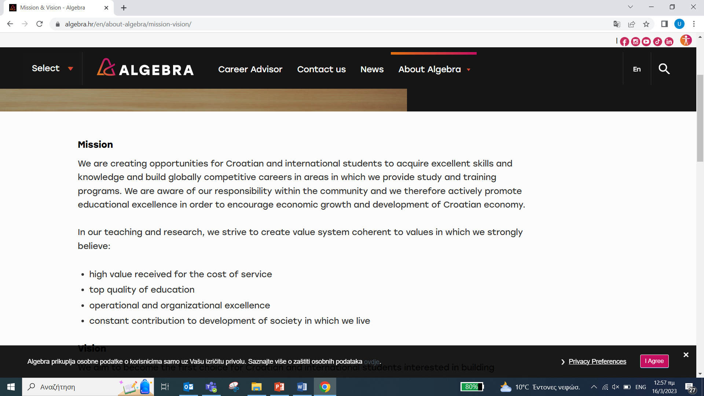
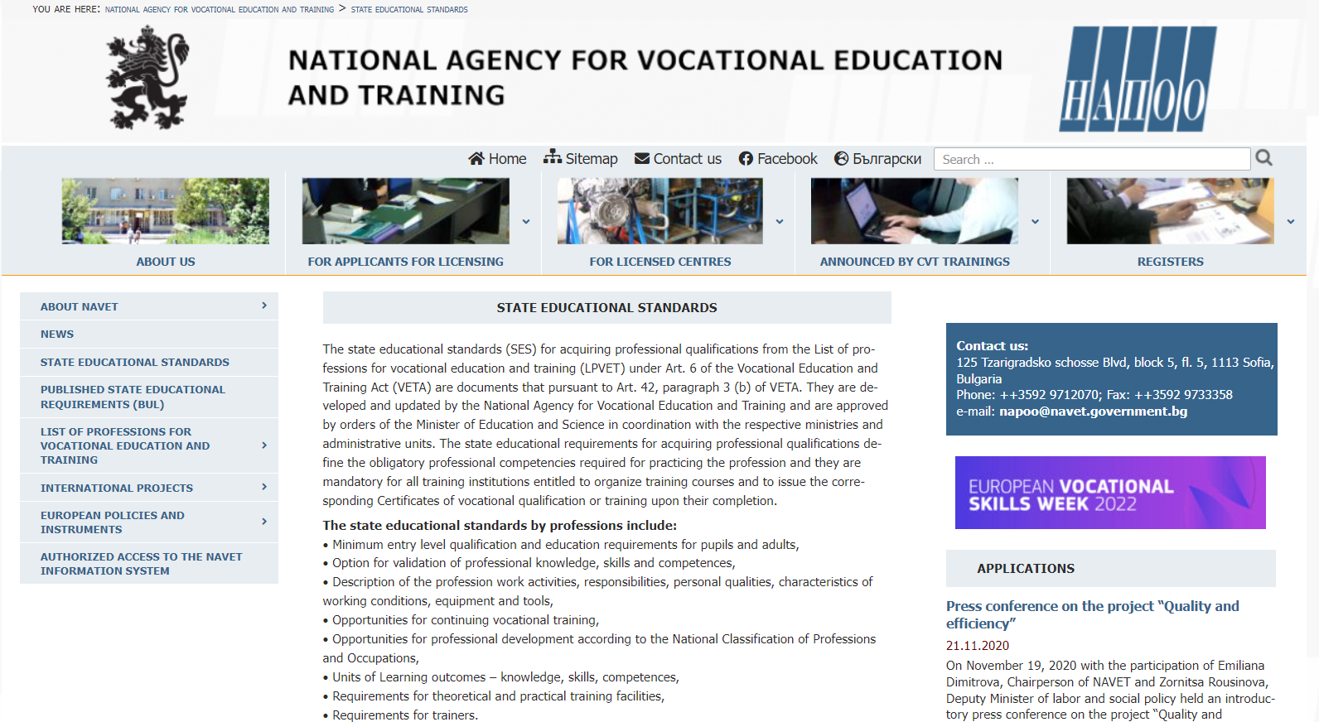
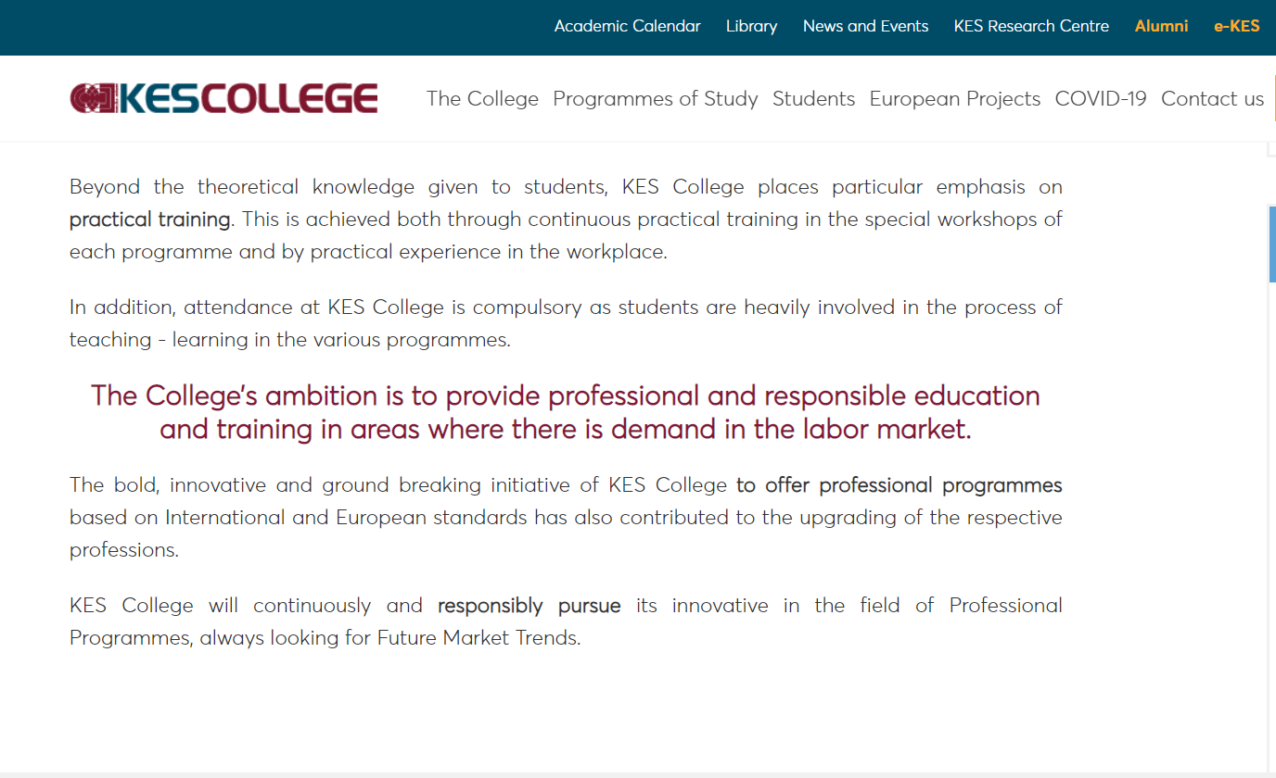
Ways to integrate SGD in the VET vision (1/2)
Here you see the real vision statements of the partnering VET institutes

Slide 17
Ways to integrate SGD in the VET vision (2/2)
Now click on each statement below to see how sexual and gender diversity could be integrated by additions to the vision statement. These are just examples to show that any vision statement can be specified to promote comprehensive inclusion.
Algebra: We offer VET students excellent skills to build international competitive careers. We have a responsibility for the community and promote educational excellence for economic growth and development.
AKMI S.A.: We empower our youth to build their destiny by moulding their character and respecting their right to learn and power to earn.
KES College: Our vision is to pioneer professional education based on European standards. We aim to maximize social impact, and to encourage new ideas, foster creativity and innovative thinking, and to promote equality and diversity.
NAVETS: As a government agency, we aim to develop a VET system that meets the dynamic requirements and needs of the labour market and to provide citizens with flexible opportunities for lifelong development of their employability.
Notes:
INSTRUCTIONS FOR IT: Hotspot
Our community responsibility translates in our ambition to secure full inclusion of trainees in the labour market and in society as a whole. This includes equal opportunities and attention for vulnerable groups like (..) and LGBTIQ+ people.
By moulding their character, we mean - among other things - that VET students become aware of their personality and are able to express themselves freely and with respect for others. This includes respect for (..) and LGBTIQ+ people.
In our promotion of equality and diversity, we have specific attention for (..) and LGBTIQ+ people.
In these areas, we recognize the need of citizens to be fully included. To be able to be yourself and have respect for others are key competences. Therefore we have specific attention for the inclusion of (..) and LGBTIQ+ people.

Slide 18
Being specific about target groups in the vision
Although it is relatively easy to find a way to embed inclusion in a VET vision, in practice advocacy attempts to specifically include sexual and gender diversity or the target group “LGBTIQ+” in a public text will often be met with skepticism. Here you find four of the most common arguments against this.
Choose the ones that you may expect in your own VET institute. For each answer, we give feedback (there are of course no ‘wrong’ answers)
It is not necessary to go into specific target groups, our vision is universal
The explicit inclusion of LGBTIQ+ in our vision will scare off students and internship providers
We have a free market vision, we don’t give preferential treatment to specific groups
We are a VET school, not an advocacy group
Notes:
INSTRUCTIONS FOR IT: Hotspot
The reality is that if we don’t mention groups, we are not really sensitive to diversity, and if we only mention cultural diversity, then it will not automatically be interpreted as relevant for sexual and gender diversity.
When some VET students or employers have questions about our inclusion policy, we need to have our answers ready. It is difficult to believe that we will give up our principles because we might get criticism for them.
Mentioning specific target groups shows that we are sensitive for the dynamics of the labour market. It does not imply that we give preferential treatment to anyone, just that we are open, dynamic and flexible.
As a VET school, we function in the middle of society. We are sensitive all the time for the multifaceted labour market and for communities of citizens and workers. This is not political activism, this is being professional.

Slide 19
Diffusion of Innovations Theory
A vision needs to be implemented. If the vision would just be a piece of paper, it would not have any impact on how people in the VET institutes behave. Even when they know the vision, it may not really be in their hearts. There has been a lot of research on how people in organizations can be won over to share the vision and to become committed to it.
Here we introduce you to one of the most important theories about this: the theory of “Diffusion of Innovations”. The researcher Everett Rogers wrote a book based on his research with this title. The notions from his research have become leading in organizational change research, theories and consultancy. The basic idea of this theory is that some employees or clients may like your innovation (like introducing sexual and gender diversity in the vision and Curriculum), while other may feel neutral or disinterested, and yet others may feel unwilling.
Everett Rogers states that in every organization there are
five types of groups, who usually make up the same
percentage of employees in each organization.
https://www.researchgate.net/figure/Examples-of-the-schematic-happy-neutral-and-sad-faces-used-in-
Experiment-2_fig1_8983270

Slide 20
Diffusion of Innovations Theory
Here you see the five groups Rogers identified. Click on each to learn more about them.
https://www.smartinsights.com/marketing-planning/marketing-models/diffusion-innovation-model/.
Notes:
INSTRUCTIONS FOR IT:
Innovators: The innovators are the people who are always up for trying new things. They will be the first to pick up initiatives around LGBTIQ+ inclusion. They are not afraid of risks or potential failure. It is good to involve the innovators at the start of the innovation.
Early adopters: The early adopters are trendsetters. They like them to be a part of new things that seem to work. In a VET team, they may be the VET Teachers who want to join innovators in experimenting with not-so-risky lessons on LGBTIQ+ inclusion. Or VET Teachers who support LGBTIQ+ VET students with their coming-out or creating a school club on the topic.
Early majority: The early majority is the more progressive part of the middle group. They are willing to go along with the early adopters when they feel that the innovation is useful and fun, and when it does not require too much effort. It is useful to involve them in pilots: the early majority is essential to later get the conservatives on board.
Late majority: The late majority thinks current habits are sufficient and sees innovation as a threat. However, they will go along with the innovation if more than half of the staff indicates that the innovation will become the new routine and “norm”. We advise to involve the late majority after the completion of the pilots and when the associated pitfalls have been overcome.
Laggards: The laggards are often traditionally minded VET Teachers who resist innovation at any cost. They may have strong religious objections to sexual and gender diversity. Ultimately, the VET school management must decide what to do with laggards who do not want to meet the new standards. They may exempt them until they retire or transfer them to another school or department.

Slide 21
Your own strategy to develop a vision
Organic growth of commitment
A main learning point from Everett Rogers is that the commitment to an innovation needs to grow organically. It is not functional to involve laggards in the beginning of an innovation, or to give them too much space for objections. When you strategically want to diffuse innovation and create commitment from all staff, you start with the innovators and gradually expand the commitment to early adopters and the early majority. The late majority will go along when the innovation is not an innovation anymore but a new routine. This organic growth does not happen by itself; the management needs to incorporate this “diffusion of innovation” mechanism in their strategy.
VET Teachers who become ambassadors for change can also make strategic choices who to cooperate with, and who to ignore in the beginning of the process. They can choose to start to cooperate with progressive managers and to involve conservative managers only when the success of the innovation is already clear. They can choose fellow-ambassadors with strategic care.
Laggards will never be won over, and can only be given an exemption or be forced to leave. For example, when laggards keep on making sexist comments in the VET school where equal treatment is the policy, this is not acceptable. And when laggards keep making marginalizing and homophobic or transphobic comments, while the VET institute has decided that LGBTIQ+ people need to be treated with respect, such behavior becomes unprofessional and unacceptable.

Slide 22
Self reflection activity
Take 10 minutes and think:
How would you apply the theory of diffusion of innovations to your situation?
Do you consider yourself an innovator or an early adopter?
If you are an innovator, who can you involve as early adopters?
You have to keep in mind that early adopters can have a big influence when they are people of high status, either in the hierarchy or because of their social standing in the team.
Which of the high status early adopters can you involve to increase the role modelling effect on the early majority?
How can you help to make the suggested interventions non threatening and easy to implement, in order to win over the early majority after the pilots?

Slide 23
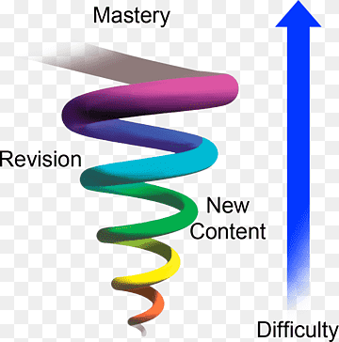
Intro of the Buner’s spiral curriculum
When we have the right vision and legitimization, we need to translate this into practice. That means it needs to be embedded in concrete VET institute regulations and the Curriculum. Going into VET institute policy and regulations exceeds the scope of the course; here we will focus on the Curriculum.
First we introduce the concept of a “spiral curriculum”.
We have already noted that a single lesson or short lesson series is not enough to establish real attitude change. Attitudes change over time. The development of tolerant, positive and supportive attitudes does not happen by itself. We need to stimulate and support it in a systematic way. One of the original theories that helps us understand how this can be done, is the theory of Jerome Bruner. He coined the concept of the spiral curriculum.
Notes:
INSTRUCTIONS FOR IT:
The idea behind the spiral curriculum is that key topics are not just treated once, but keep returning throughout the (VET) student’s learning pathway. When (VET) students get acquainted with the topic, the theme is introduced in a rather simplified and non-threatening way. Later on, the topic returns but not as a simple repetition. The content is updated with new information and emotional triggers and the way the topic is discussed becomes more challenging. This causes the (VET) students to review the earlier simplified information and responses they had. It results in an increased mastery of the theme, with the (VET) students being able to look more in-depth at the theme, and while doing this, change their normative framework to consider issues in a more nuanced way.
The best way to teach VET students adequate positive and supportive attitudes like tolerance, respect, inclusion and sensitivity to diversity is to embed those key competences in the existing regular curriculum. This requires us to have a look at the curriculum and to see where it can be adapted throughout all subjects and throughout the entire vocational training pathway.

Slide 24
Krathwohl’s taxonomy (1/2)
So, how do we build up “tolerant, positive and supportive attitudes” systematically?
Can we do this at all? Is it not indoctrination?
Indoctrination means to instill specific thoughts and attitudes in people. This is not what we want to do. We want to encourage empowerment of VET students and critical thinking, so that they can construct their own values and actions. They may need to strengthen agreements on behavioural norms but in some cases they also need to learn how to resist norms that are discriminating, excluding and dysfunctional. As an educational institution we can train this. Whether VET students use these skills remains their own choice. Still, practice shows that when you train students on critical thinking, including emotional and attitudinal self-reflection, this commonly leads to a more nuanced view, less fear of differences, more tolerance, and more support for diversity.

Slide 25
Krathwohl’s taxonomy (2/2)
The educational experts Bloom, Krathwohl and Anderson developed a way to get more insight on how schools and teachers can systematically promote critical reflection on the attitudinal level. They first developed the Taxonomy of Objectives for the Cognitive Domain (knowledge) and then corresponding taxonomies for the Affective (emotional and attitudinal) and the Psycho-Motoric (skills) Domains. The taxonomy of cognitive objectives (which is usually called the taxonomy of Bloom) is most famous and is often a standard resource in training institutions. The taxonomy of affective objectives (which is usually called the taxonomy of Krathwohl) is much less known. Because it is so important for our purpose, we go into it here. We are presenting a version that is slightly edited by GALE for the needs of teaching about sexual and gender diversity.

Slide 26
The taxonomy of affective goals
The Taxonomy of Krathwohl has five levels. Getting (emotional) “attention” is the start level. “Characterisation” is the highest level.
Click on each of the levels to know more about each level.
Attention
Interest
Appreciation
Reorganisation
Characterisation
Notes:
INSTRUCTIONS FOR IT: Hotspot
Attention: Especially if there is resistance to a topic, a (VET) Teacher first needs to overcome the taboo and get the attention of (VET) students. You do this with a trigger that surprises them and has a link to sexual and gender diversity. Then you shift the attention to (sexual and gender) diversity. You can use triggers such as movies and interactive exercises, (sensitive) humour works also very well. The result of this phase is passive attention rather than resistance or refusal to participate.
Interest: When the (VET) teacher has the attention, the next step is to stimulate authentic curiosity of the (VET) students. You can do this by framing diversity in broader issues that interest VET students, like respect, dating, relationships, gender and exclusion. You can ask them challenging questions and discuss dilemmas to engage them in a non-judgmental dialogue about these topics. The result of this phase is that VET students change from passive to active participants in the discussion.
Appreciation: When they are actively engaged, there is space for (VET) students to form and express opinions on how to deal with sexual and gender diversity. The (VET) teacher should point out that a respectful and client friendly attitude is important for their vocational training. You can facilitate this through small group exercises, strongly facilitated dialogue, simulation games and role-play. The results of this phase is that VET students express their feelings with respect and without judging others.
Reorganization: (VET) students may have formed some positive opinions on supporting LGBTIQ+ fellow VET students or future clients, but at the same time they may still have some negative opinions on non-normative behaviour. Their primary opinions are not yet aligned with their general value framework. You can stimulate a more in-depth reflection on values and norms so that (VET) students get a deeper understanding and their attitude becomes less judgmental and more nuanced (tolerant). The result of this phase is that (VET) students adapt their value frameworks to become more aligned with a more general and sustainable, open and friendly attitude.
Characterization: Having an open and friendly attitude does not automatically mean that (VET) students can always act on this in practice. Daily life will confront them with a range of challenges to remain true to their positive values. You can train your (VET) students to become more stable in this by exercising how to deal with challenges through discussion of case studies, simulation games and role-play. The result of this phase is that (VET) students are better able to resist the practical challenges of homophobia and transphobia in their personal and professional environments.

Slide 27
Self reflection activity: a possible structure for a spiral Curriculum including sexual and gender diversity
Students explore their primary feelings around diversity, exclusion and sexual and gender diversity
Students orient themselves on what it means to be professional and what gender and sexuality have to do with that
“VET students align their own values and norms concerning sexuality and gender with the expected professional practice
VET Students orient themselves on what it means to be professional and what gender and sexuality have to do with that”
“VET students learn to authentically and empathically listen, including to LGBTIQ+ clients or customers”
 | Year 1 | Year 2 | Year 3
VET students explore their primary feelings around diversity, exclusion and sexual and gender diversity”
“VET students explore how they will deal with negative or unsupportive challenges to their professional attitude concerning sexuality and gender”
“VET students form an opinion about sexual and gender diversity and learn to formulate it with respect for others”
Notes:
INSTRUCTIONS FOR IT: Make sure that the order of the answers is mixed up so that it is not obvious which answer below to which category. If the participants drag the objective to a ‘wrong’ category, it will just jump back until they drag it to the right category.
Correct answers:
Year 1
Answer 1 Students explore their primary feelings around diversity, exclusion and sexual and gender diversity
Answer 2 Students orient themselves on what it means to be professional and what gender and sexuality have to do with that
Year 2
Answer 3 Students learn to authentically and empathically listen, including to LGBTIQ+ clients or customers
Answer 4 Students form an opinion about sexual and gender diversity and learn to formulate it with respect for others
Year 3
Answer 5 Students align their own values and norms concerning sexuality and gender with the expected professional practice
Answer 6 Students explore how they will deal with negative or unsupportive challenges to their professional attitude concerning sexuality and gender
FEEDBACK THAT APPEARS WHEN ALL PHRASES ARE ON THE RIGHT ORDER:
“You may notice that there is only one objective related to “characterization” and that it is formulated as “exploring how”. This is because affective goals related to characterization are usually learned over time and in real work practice. Vocational training may be able to explore how to do this but this systematic implementation of positive values needs to be learned in practice and may be a lifelong journey.

Slide 28
How to start developing a spiral curriculum
How can you introduce the idea of embedding sexual and gender diversity in a spiral curriculum to your team?
One way of doing that is to plan a brainstorming activity on the ideal spiral curriculum at the end of training. We will present it briefly here but you can check the full version on the online platform (practical assignment document) and carry out this exercise in your classroom.
Brief presentation of the idea of a spiral curriculum (see Bruner)
Design of a matrix with the components (see image below)
Formulation of two (or more) groups to deliver the brainstorming activities; one subgroup brainstorms on the order of attitudinal objectives, the other(s) on embedded classroom activities per subject.
Actual delivery of the brainstorming activities
Debriefing session and presentation of findings; re-ordering of objectives and activities if necessary.

Slide 29
Self reflection activity: how to start developing a spiral curriculum
You may now reflect on how you can organize this type of spiral curriculum brainstorming activity.
Choose some of the preconditions that are necessary to make this a success. With each choice, we give some feedback.
Before doing this activity, it is necessary to organize a lecture explaining the spiral curriculum by Bruner and the taxonomy of affective goals by Krathwohl.
All subjects need to be covered because all VET Teachers need to be consistent in their approach of gender and sexual diversity.
You need to involve the team manager in the planning and follow-up of this exercise.
You need to invite the future members of the spiral curriculum working group even before this training starts.
Notes:
INSTRUCTIONS FOR IT: Feedback on each answer
You could do this, and it would save some time during the training, but it is not really necessary. The explanation of the spiral curriculum by Bruner can be short and concise like we did in this unit. The explanation of the taxonomy of Krathwohl is quite theoretical when done without context, and will work better when you present it briefly after the presentation and discussion of the first poster on objectives and then apply it to improve on the brainstormed objectives.
It is certainly true that implementation works best when the entire team is aligned in its attitude towards sexual and gender diversity. However in practice, most VET course teams will focus on embedding the main thread of the spiral curriculum in two or three subjects. Other VET teachers may get inspired by this to plan aligned activities in their own subjects, or to engage in unplanned ad hoc activities or to make aligned pedagogic remarks. Forcing all VET teachers to engage in a spiral curriculum from the very beginning is not the most effective way to gradually build a growing commitment in the team.
This is a very good recommendation. If you really want the brainstorming activity to be followed up and result on the development of a real spiral curriculum with sexual and gender diversity embedded in it, the team manager has to organize this and make sure that a working group is convened and invited for the first meeting and that it has continuity to finish and implemented their work.
This might be a good idea. It sometimes happens that team teachers feel plumped upon when after the brainstorming activity, they are suddenly invited to stand up to join a working group. This could stall the enthusiasm the activity itself creates. Before the training, it can be discussed with the team manager who would be the best “innovators” and “early adopters” to form the core of the working group and how to invite them in a diplomatic way. The full support of the team manager and possibly some additional working hours to compensate for the invested work time will help convince the invited VET teachers to be part of the working group. The call for the working group after the brainstorming activity can still be presented as voluntary. The approached VET teachers will volunteer, but it will also create space for other VET teachers that are inspired to also step forward. This way, the working group will not appear to be a top-down managerial intervention.

Slide 30
Conflict management
By now, you should have realized how important it is to have an institutional vision which includes sexual and gender diversity in order to legitimize your actions as professionals. You should have also understood that a vision without implementation could become a dead letter, while implementation by heart requires a gradual growth of commitment in the VET team or institute. The Diffusion of Innovations theory of Rogers helped us to understand that we need to approach innovators and early adopters first, and – at first –not to give too much attention to laggards who are not open to review their objections.
Good intentions need concrete tools to be translated into practice. We suggested that developing a spiral curriculum is one of the best ways to make sure that good intentions of the team translate into real activities for VET students. In this regard, taxonomy of affective objectives by Krathwohl is a good guideline to help plan such a Curriculum.
Training VET Teachers, formulating a vision, extending the commitment in the team, and developing a spiral curriculum are preventive strategies which help to avoid conflicts around the topic of sexual and gender diversity. If such preventive measures are not in place, it is easier for conflicts to arise and for escalate into a small or larger crises.
But even when you do have these preventive strategies into place, it still can lead to negative feedback from inside or outside your VET institute. Now we will explore how we can manage internal or external conflicts and crises. We will give attention on how to assess the seriousness of risks and how to prevent escalation.

Slide 31
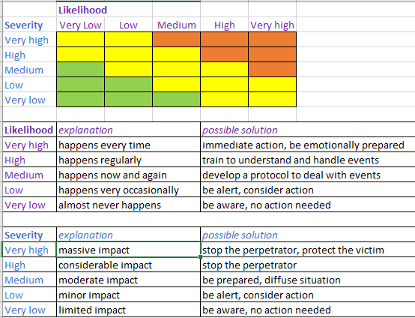
A conflict assessment matrix
Even if someone is trained on how to handle objections, there is always a risk that they may feel uncomfortable to object or try to block activities; it is possible that VET Managers, Teachers or Students act inadequately out of fear or lack of a proper assessment of the situation.
In the following slides, we offer a way to assess and deal with these risks. We do this in a general way, by providing some realistic examples. Every risk, whether potential or immediate, is unique and needs to be treated like that. The biggest risk is that involved stakeholders “panic” because their “fight or flight” impulse tends to respond aggressively or denying the risk situation. The most important way to deal with risks is to realize that such “panic” may happen and not fall into the trap of responding immediately based on their first impulses.
Here we offer you a risk assessment matrix (provided also as a separate Excel sheet in the MOOC platform), to describe and analyze the risks and agree on appropriate prevention and handling of each risk. The matrix can be used to describe the risk event, and to assess the possible negative impact by agreeing on the levels of likelihood and severity of the risk.

Slide 32
A conflict assessment matrix
You can try now how it works by yourself. For this exercise, we have simplified the risk assessment matrix to 6 instead of 25 nuances. Drag and drop the described risks to the category they belong to.
A lesbian (VET) student is raped behind the football field by male students “to make her straight again”
An androgenous looking VET student who is not identifying as non-binary is socially isolated and eventually burns out
A gay VET student falls in love with a not-out bisexual student; who then starts to send him photos with inappropriate content
A VET trans student starts her transition and some students make denigrating remarks in class
A VET teacher forgets the name of a trans VET student and excuses himself
An openly gay VET student is called names from a distance
Notes:
INSTRUCTIONS FOR IT: Interactive table for a drag & drop exercise. Each letter corresponds to a certain position.
A. Low likelihood, high severity
B. High likelihood, high severity
C. Low likelihood, medium severity
D. High likelihood, medium severity
E. Low likelihood, low severity
F. High likelihood, low severity

Slide 33
How to develop solutions appropriate for the risks
After assessing the type of risk, you need to develop appropriate solutions.
Along which lines do you think should solutions be developed to be appropriate?
All risks should be treated with equal measures
More severe risks should be anticipated in policy and the indicated measures should be described
More likely risks should be anticipated in policy and the indicated measures should be described
All risks should be looked at on their own merit and treated differentially depending on the context
Notes:
INSTRUCTIONS FOR IT:
Correct answer is C
FEEDBACK CORRECT:
Because more likely risks can be predicted as they are part of the school culture; it is possible to make a prevention and correction policy on them. This will also create a foundation for a school culture that ultimately prevents less likely and severe risks.
FEEDBACK INCORRECT:
A. Treating all risks equally would lead to events being underestimated or overestimated, which would create unfairness. You don’t treat a rape as equal to scolding.
B. It would be good if severe risks could be covered by policies, but they actually don’t happen that often. So although severe risks need to be seriously looked at, policy on them will only be sensible when they are also more likely to occur. Of course, the government may make it mandatory for a VET institute to have a policy on some severe risks that apply to all VET institutes and schools, even when they possibly don’t occur that often (for instance on sexual harassment).
D. Treating all risks depending on their context would imply that the strategy would become dependent on the subjective judgements of the VET teachers or managers dealing with the risk.

Slide 34
The Conflict Escalation Ladder
Risks don’t turn into a crisis automatically. They tend to start small, with uncomfortable feelings and disagreements, and then can escalate into a more serious conflict or crisis. During this escalation, the disagreement grows into a conflict which may get out of hand and will become increasingly unmanageable.
The conflict escalation ladder illustrates how the escalation of disagreements can evolve. It also helps to see how risks and disagreements can be stopped in early stages, or de-escalated by toning down the conflict.
There are many models for conflict escalation ladders. We present here a simpler version of Friedrich Glasl model. He distinguishes nine steps, which he subdivides in three levels: conflict is a problem, escalating into a struggle, and further escalating into a war.
Click on each of the steps to learn more about what Glasl describes as stages of conflict
Conflict as a problem
Conflict as a struggle
Conflict as a war
Notes:
INSTRUCTIONS FOR IT: HOTSPOT
Conflict is a problem: The first level of conflict is still a possible win-win situation.
Tensions: the conflicts start with tensions, for example by an occasional clash of feelings or opinions. This is often not perceived as part of a conflict but a normal occurrence.
Debate: the tensions lead to a dispute. The parties try to put each other under pressure and start to think in terms of black and white.
Communication breakdown: the parties lose trust in an agreement. Discussions are broken off. Sympathy for “the others” disappears.
Conflict as a struggle: On the second level the conflict becomes a win-lose situation.
Coalitions: the focus of the conflict shifts to win sympathizers over for one's cause and denounce the opponent. The issue is no longer important: one has to win the conflict so that the opponent loses.
Loss of face: having brought enough sympathizers on board, the struggle moves on to make the “enemy” lose face by attacking its moral credibility. The loss of trust becomes complete.
Threats: the parties try to “win” with threats in the form of demands and sanctions.
Conflict as a war: On the third level, the conflict has become a lose-lose situation.
Limited destruction: the parties try to damage the opponent, who is now no longer regarded as truly human. Limited personal loss is seen as acceptable if the damage to the opponent is greater.
Total annihilation: parties attempt to annihilate the opponent by all means.
Together into the abyss: even personal annihilation is accepted in order to defeat the opponent.

Slide 35
How to de-escalate
What strategies are available to de-escalate conflicts? Drag and drop the strategies to the appropriate phase.
Mediation
Problem | Struggle | War
Process guidance
External forcible intervention
Mediation
Empathic listening
Socio-therapeutic counselling
Arbitration
Notes:
Problem
Empathic listening
Mediation
Struggle
Process guidance
Socio-therapeutic counselling
War
Arbitration
External forcible intervention

Slide 36
Self reflection activity: managing risk
1. A student makes an offensive remark about gay people in class. What is the risk and how should it be dealt with?
It is best to ignore this. This ensures that such events do not repeat. Also, not blowing this up prevents escalated conflict.
The VET teacher should act immediately and forbid any scolding in class. It is not advisable to discuss sexual and gender diversity in class at this time. This will just create a tension that may escalate.
The potential risks are that the VET teacher panics and allows the student to add to a negative school culture. There should be a school policy on how to deal with such comments. The VET teacher should not respond based on instinct.
It depends on whether there are LGBTIQ+ VET students in class. When there are, such students may feel hurt and the VET teacher needs to make the scolding students aware of this.
Notes:
Correct answer is C
FEEDBACK CORRECT:
This is the best answer.
FEEDBACK INCORRECT:
A. This is not advisable. The VET student himself and his peers may think that this is an acceptable remark. It will add to a negative VET institute culture and individual LGBTIQ+ VET students may feel hurt and unsafe.
B. It is quite common that VET Teachers forbid negative behaviour, but don’t go into controversial content. The VET student may get the impression that although scolding is forbidden, his homophobic attitude is legitimate.
D. This is an underestimation of the seriousness of the risk. An offensive remark does not only hurt individual LGBTIQ+ VET students but also sets a tone in the entire VET institute culture.

Slide 37
Self reflection activity: managing risk
2. A parent complains to the management about a VET Teacher who teaches “inappropriate” topics. What is the risk and now should it be dealt with it?
The risk is that the VET Teacher actually teaches sexuality in an inappropriate way. It is best to first do a thorough research into this and send the VET Teacher on leave while the research is underway.
The risk is that there is a misunderstanding, which may result in an escalation and a debate that is not based on facts. It would be better for the Manager to organize a mediation meeting between the Teacher and the parent.
The risk is that the complaint of the parents becomes public and will damage the image of the VET institute. This is a very serious PR risk. To avoid any escalation, it is advisable to tell the VET Teacher to immediately drop this topic.
The risk is that management may respond inadequately, resulting in labour conflict, conflict with parent(s) and PR-damage. Therefore, it is necessary to ensure that there is an adequate complaint procedure in place and train support counsellors and managers to be unbiased against gender or sexual diversity. A "no-blame" approach could be part of the VET institute policy.
Notes:
Correct answer is D
FEEDBACK CORRECT:
This is the best answer.
FEEDBACK INCORRECT:
A. By giving the parent the impression that the management does not trust their own VET Teachers, a message is sent that teaching about sexual and gender diversity is controversial indeed and may easily be construed as inappropriate. When this happens, no other VET Teacher will ever dare to teach on this topic again.
B. Although it is laudable to look for the facts, organizing a mediation meeting will give the parent the impression there is something to negotiate. However, teaching about human rights and inclusion should not be negotiable. A mediation meeting will show that the VET institute doesn’t have a clear vision and will make the VET Teacher vulnerable.
C. In this scenario, the manager is “struggling” which makes it not possible anymore to reflect on the content of the complaint, but only on the innuendo and the fear of losing face. A possibility for an unbiased reaction is overdrawn and the whole situation is dysfunctional.

Slide 38
Self reflection activity: managing risk
3. A local media outlet comes with an unexpected negative story about how your institute is engaging in indoctrinating VET students in “gender ideology”. The story is riddled with half-truths and accusations. What is the risk and now should be dealt with?
The risk is that the management panics, resulting in loss of face, possible labour conflict and PR-damage. This can be prevented by anticipating such risks and making a protocol on how to respond without dropping the policy.
The risk is that the management panics, resulting in loss of face, possible labour conflict and PR-damage. This can be prevented by training the management how to handle their fears.
The risk is that the story is mistaken for true news and that the image of the VET institute will be damaged. The media outlet should be taken to court and forced to publish corrections and an apology.
The risk is that the story is mistaken for true news and that the image of the VET institute will be damaged. It should cooperate with other media outlets to counter fake news with real information about the programme.

Slide 39
Suggestions and tips
In the previous slides, we focused on how we can assess risks and which type of solutions may be appropriate. The more frequent risks arise, the more we advise to manage risks by making a policy on it. More serious risks do not happen very frequently but need to be handled with care.
VET institutes need to be careful not to fall in the trap of reacting on risks with first impulses. It is also wise to see in what stage of conflict people are, and how the conflict can be de-escalated. A few case studies show that handling risks may be complicated in reality. However some of the below suggestions remain important:
Prepare for risks by discussing scenarios
Develop a policy and interventions for frequent risks and (potential) conflicts
Create community support for your vision and policies
Make sure existing risk strategies also apply equally to conflicts around LGBTIQ+ issues
When a risk of conflict arises, don’t panic and do not act on impulse
Notes:
Correct answer is A
FEEDBACK CORRECT:
This is the best answer.
FEEDBACK INCORRECT:
B. Although training of the management in handling crises - including not to base their reaction on first impulses - is a very good intervention, it may not be enough to ensure that individual managers do not fall into the “fight or flight” trap. We need to realize that homophobia and transphobia are rooted in cultural and political phenomena and prevention of it needs to be regulated, just like VET institutes regulate equal treatment of sexes and prevention of sexual harassment.
C. It is laudable to intend to correct fake news, but we should realize that the discourse on “gender ideology” might be a targeted strategy led or supported by political or religious groups. In some countries, a judge may well interpret accusations of “gender ideology” to be part of the freedom of expression and the freedom of religion.
D. It is laudable to intend to correct fake news, but we should realize that the discourse on “gender ideology” might be a targeted strategy led or supported by political or religious groups. Positive counter-discourses may be helpful, but it probably requires a broader community and political strategy to effectively counter gender ideology discourse.

Slide 40
Learning Outcomes
Now that you have completed this topic, you should be able to:
realize how irrational fear of conflict may inhibit you from undertaking
the right actions
decide which type of training may be useful in your specific situation to
advice your colleagues and administration on possible conflicts
help your institute embed sexual and gender diversity in the institutional
vision and make it work in practice by creating commitment and developing
a spiral curriculum
know how to analyze risks and to undertake appropriate actions

Slide 41
List of References
Bloom, Benjamin; Engelhart, M. D.; Furst, E. J.; Hill, W. H.; Krathwohl, D. R. (1956). Taxonomy of educational objectives: The classification of educational goals. Vol. Handbook I: Cognitive domain. New York: David McKay Company (see https://en.wikipedia.org/wiki/Bloom%27s_taxonomy)
Dankmeijer, Peter (2020). Three Programs for Orientation Training on Sexual and Gender Diversity (upload in library)
Dankmeijer, Peter (2022) Recruiting and Coaching UNIQUE Ambassadors. Internal memo for the UNIQUE project (upload in library, see Dankmeijer-2022-Recruiting_and_Coaching_UNIQUE_Ambassadors.pdf)
Dankmeijer, Peter (2022). Risk assessment matrix (Excel version) (upload in library)
Glasl, Friedrich (2009). Conflict escalation and conflict management (see https://en.wikipedia.org/wiki/Friedrich_Glasl%27s_model_of_conflict_escalation, see also https://www.mediate.com/glasls-nine-stage-model-of-conflict-escalation/)

Slide 42
List of References
Krathwohl, David; Bloom, Benjamin; Masia, B. B. (1964). Taxonomy of educational objectives: The classification of educational goals. Vol. Handbook II: the affective domain. New York: David McKay Company. (see https://sites.google.com/site/elearningsnippets/a-wiki-page/krathwohl-s-taxonomy and https://quincycollege.edu/wp-content/uploads/Anderson-and-Krathwohl_Revised-Blooms-Taxonomy.pdf)
Rogers, Everett (1985). Diffusion of innovations. New York: The Free Press (see https://en.wikipedia.org/wiki/Diffusion_of_innovations)
UNESCO on inclusion: https://www.unesco.org/en/education/inclusion
UNESCO (2018) Recommendations 48th session of the International Conference on Education (http://www.ibe.unesco.org/fileadmin/user_upload/Policy_Dialogue/48th_ICE/CONFINTED_48-5_Conclusions_english.pdf)

Slide 43
Thank you!

